Slide 1
Udyog Saarthi App
PIP4004 Capstone Project
Review-0
Batch Number:CSE-G138
Under the Supervision of,
Dr. KUPPALA SARITHA
Professor
School of Computer Science and Engineering
Presidency University
20211CSE0321 | RAHUL YADAV.B
20211CSE0503 | MOHANA RANGA.T
20211CSE0734 | SHAIK IRFAN
20211CSE0779 | BHARATH REDDY.B
20211CSE0769 | TEJESH REDDY
Roll Number | Student Name
Name of the Program: CSE
Name of the HoD: Dr.Asif Mohammed H.B
Name of the Program Project Coordinator: Mr. Amarnath J.L & Dr. Jayanthi. K.
Name of the School Project Coordinators: Dr. Abdul Khadar A

Slide 2
Content
Problem Statement
Github Link
Abstract
Analysis of Problem Statement
Timeline of the Project
References

Slide 3
Problem Statement Number: PSCS_56
Technology Bucket :Ministry of Social Justice and Empowerment
Category (Hardware / Software / Both) : Software
Problem Description: Persons with disabilities in our country, despite the progress happening on accessibility, education, skills development, and employment, still face many challenges, especially in the employment phase of life that promotes inclusion in the family and society. Enhancing vocational training and employment prospects for people with disabilities is essential and there are efforts happening at the National level that has to end up in employment that fetches significant economic benefits and dignified life for them. E categories of 4% reservation in Government and PSU Jobs (Persons with disabilities of type, Intellectual Disability, Autism Spectrum Disorder,) are either not aware of or not getting notifications regarding the employment vacancies, queries, or other such information due to the unavailability of access to print media, and online services like employment news.
Difficulty Level: Complex

Slide 4
Github Link
The Github link provided should have public access permission.
GitHub Link:
https://github.com/rahulyadav00325/udyog-saarthi-app.git

Slide 5
Abstract
Despite progress in accessibility, education, and skills development, persons with disabilities (PwDs) in India continue to face significant challenges in securing employment. According to the Ministry of Statistics, 64% of PwDs remain unemployed, with the most vulnerable groups (D & E categories) struggling due to lack of awareness, inaccessible job notifications, and inadequate training support. This proposal outlines a software solution aimed at bridging this gap by providing accessible job information, training resources, tracking mechanisms, and workplace support. By collaborating with government bodies and NGOs, this initiative seeks to enhance employment opportunities, promote inclusion, and ensure dignified livelihoods for PwDs.
Keywords :- Employment, Accessibility, Disabilities, Inclusion, Training, Awareness .

Slide 6
Analysis of Problem Statement
1. Problem Identification
Employment Gap: 64% of Persons with Disabilities (PwDs) in India are unemployed.
Limited Awareness: Many PwDs, especially in the D & E categories, are unaware of job vacancies due to accessibility barriers in print and online media.
Parental Awareness: Parents of PwDs often lack the literacy or information required to guide their children in job applications.
Competitive Exam Challenges: Lack of proper training, coaching facilities, and mock tests hinder PwDs from qualifying for government and PSU jobs.
Workplace Adaptation Issues: Even when employed, PwDs face challenges related to workplace accessibility and reasonable accommodation.

Slide 7
Analysis of Problem Statement (contd...)
2. Gaps in Current System
Lack of centralized information on job openings.
Insufficient awareness and accessibility to job-related updates.
Limited structured training and mock exams tailored for PwDs.
Absence of tracking mechanisms for job applications and career progression.
Inadequate post-employment support for workplace adaptation.
3. Existing Efforts
Government initiatives like the 4% reservation in government and PSU jobs aim to improve employment opportunities.
Organizations such as DEPwD and NIEPMD provide training and job coaching services.
NGOs play a role in assisting PwDs with applications, training, and workplace adaptation.

Slide 8
Analysis of Problem Statement (contd...)
4. Proposed Solution: Software Application
Learning Profile Creation: Digital record of PwDs’ skills, literacy levels, assistive needs, and job aspirations.
Job Notifications: Curated, accessible information on government, PSU, and private-sector opportunities.
Training and Mock Tests: Accessible resources for exam preparation and skill development.
Application Tracking System: Monitoring job applications, exam attendance, and interview results.

Slide 9
Analysis of Problem Statement (contd...)
5. Expected Impact
Increased employment among PwDs by improving accessibility to job-related information.
Enhanced skills and qualifications through structured training programs.
Greater parental involvement and awareness in their children’s job search.
Strengthened implementation of the Rights of Persons with Disabilities Act, 2016.
Creation of a more inclusive workforce with necessary accommodations and job security.

Slide 10
Analysis of Problem Statement (contd...)
Expected Challenges
Limited Digital Accessibility: Ensuring the software application is fully accessible to PwDs with diverse disabilities (visual, cognitive, mobility, etc.).
Awareness & Outreach: Reaching the target audience, especially those unaware of government job reservations and training opportunities.
Data Collection & Verification: Gathering accurate learning profiles and employment status of PwDs while ensuring data security.
Integration with Government & PSU Systems: Collaborating with public sector bodies to synchronize job notifications and application processes.
Parental & Caregiver Involvement: Educating and engaging parents/caregivers who may have low digital literacy.

Slide 11
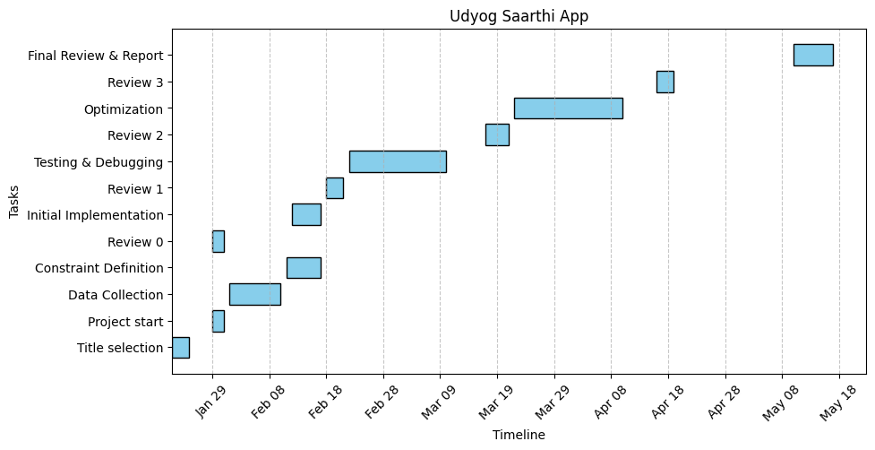
Timeline of the Project (Gantt Chart)

Slide 12
References (IEEE Paper format)
Ministry of Statistics and Programme Implementation (MoSPI), Government of India. (Latest Report on Persons with Disabilities in India)
Provides statistical data on employment rates and challenges faced by PwDs in India.
The Rights of Persons with Disabilities (RPwD) Act, 2016.
Legal framework governing employment rights, reservations, and accessibility provisions for PwDs.
Department of Empowerment of Persons with Disabilities (DEPwD), Government of India.
Policies, job reservation schemes, and initiatives supporting PwD employment.
National Institute for Empowerment of Persons with Multiple Disabilities (NIEPMD).
Research, training programs, and job coaching services for PwDs in India.
International Labour Organization (ILO) Reports on Disability and Employment.
.

Slide 13


